Slide 1
Routing protocols for ad hoc networks

Slide 2
Ad hoc networks
OUTLINE:
Introduction
Classification
Proactive routing protocols
Reactive routing protocols
Hybrid routing protocols
Hierarchial routing protocols
Power-aware routing protocols
2

Slide 3
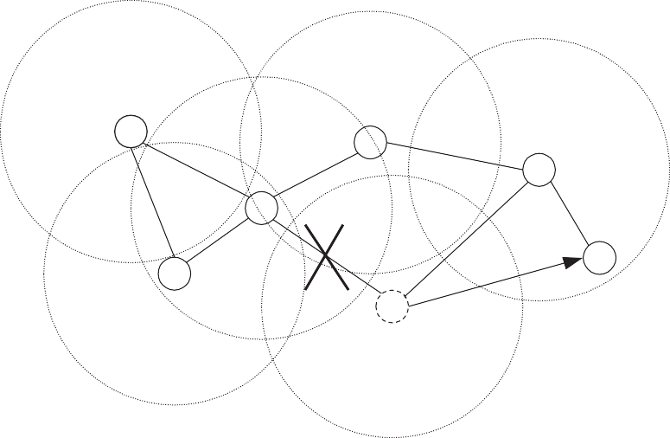
Introduction
What we have in ad hoc environment:
dynamically changing topology;
absence of fixed infrastructure and centralized administration;
bandwidth constrained wireless links;
energy-constrained nodes.
Link loss is one of the biggest problem for routing.
3

Slide 4
Challenges of routing protocols in ad hoc networks
The following are the main challenges:
Movement of nodes:
Path breaks;
Partitioning of a network;
Inability to use protocols developed for fixed network.
Bandwidth is a scarce resource;
Inability to have full information about topology;
Control overhead must be minimized.
Shared broadcast radio channel:
Nodes compete for sending packets;
Collisions.
Erroneous transmission medium:
Loss of routing packets.
4

Slide 5
Design goals
Goals that must be met:
must be scalable;
must be fully distributed, no central coordination;
must be adaptive to topology changes caused by movement of nodes;
route computation and maintenance must involve a minimum number of nodes;
must be localized, global exchange involves a huge overhead;
must be loop-free;
must effectively avoid stale routes;
must converge to optimal routes very fast;
must optimally use the scare resources: bandwidth, battery power, memory, computing;
should provide QoS guarantees to support time-sensitive traffic.
5

Slide 6
Classification of routing protocols
Routing protocols for ad-hoc wireless networks can be classified based on:
routing information update mechanism;
usage of temporal information (e.g. cached routes);
usage of topology information;
usage of specific resources (e.g. GPS).
6

Slide 7
Based on routing information update mechanism
Proactive (table-driven) routing protocols;
Reactive (on-demand) routing protocols;
Hybrid protocols.
Based on usage of temporal information
Based on past temporal information;
Based on future temporal information.
Based on the routing topology
Flat topology routing protocols:
Hierarchial topology routing protocols:
Routing based on utilization of specific resources:
Power-aware routing;
Geographical information assisted routing.
7

Slide 8
Routing protocols for ad-hoc networks
Routing information update
Temporal information for routing
Proactive
Reactive
Hybrid
Past history
Predictions
DSDV; WRP; CGSR; STAR; OLSR; FSR; | DSR; AODV; ABR; SSA; FORP; PLBR. |  | CEDAR; ZRP; ZHLS. | DSDV; WRP; STAR; DSR; AODV; FSR; | FORP; RABR; LBR.
HSR; GSR. |  |  |  | HSR; GSR.
Classification of routing protocols
8

Slide 9
Routing protocols for ad-hoc networks
Utilization of specific resource
Topology information
Power-aware
Geographical
Flooding
Flat
Hierarchial
- PAR.
- LAR.
DSR;
AODV;
ABR;
SSA;
FORP;
PLBR.
CGSR;
FSR;
HSR.
Proactive
Reactive
- OLSR.
- PLBR.
Classification of routing protocols, contd…
9

Slide 10
Ad hoc networks
D.Moltchanov, TUT, 2009
Proactive routing protocols
These are table-driven protocols.
We consider:
destination sequenced distance vector routing protocol (DSDV);
wireless routing protocol (WRP);
cluster head gateway routing protocol (CGCR).
source-tree adaptive routing protocol (STAR);
Common advantages and shortcoming of these protocols:
• +: low delay of route setup process: all routes are immediately available;
−: high bandwidth requirements: updates due to link loss leads to high control overhead;
−: low scalability: control overhead is proportional to the number of nodes;
−: high storage requirements: whole table must be in memory.

Slide 11
Destination sequenced distance vector routing protocol (DSDV)
Modification of the Bellman-Ford algorithm where each node maintains:
the shortest path to destination;
the first node on this shortest path.
This protocol is characterized by the following:
routes to destination are readily available at each node in the routing table (RT);
RTs are exchanged between neighbors at regular intervals;
RTs are also exchanged when significant changes in local topology are observed by a node.
RT updates can be of two types:
incremental updates:
take place when a node does not observe significant changes in a local topology;
full dumps:
take place when significant changes of local topology are observed;

Slide 12
1
3
Dest | Next | Dist
6 | 3 | 2
5 | 3 | 2
4 | 2 | 2
6
4
5
2
Example of routing table in DSDV.
The reconfiguration of path (used for ongoing data transfer) is done as follows:
the end node of the broken link sends a table update message with:
broken link’s weight assigned to infinity;
sequence number greater than the stored sequence number for that destination.
each node re-sends this message to its neighbors to propagate the broken link to the network;
even sequence number is generated by end node, odd – by all other nodes.
Note: single link break leads to the propagation of RT updates through the whole network!

Slide 13
1
3
1
3
Dest | Next | Dist
6 | 3 | 3
5 | 3 | 2
4 | 2 | 2
6
4
5
4
5 6
2
2
Route update in DSDV.
Route maintenance in DSDV is performed as follows:
when a neighbor node perceives a link break (node 3):
it sets all routes through broken link to ∞;
broadcasts its routing table.
node 5 receives update message, it informs neighbors about the shortest distance to node 6;
this information is propagated through the network and all node updates their RTs;
node 1 may now sends their packets through route 1 − 3 − 5 − 6 instead of 1 − 3 − 6.

Slide 14
Wireless routing protocol (WRP)
Each node maintains the following:
Distance table (DT) containing network view of the neighbors of the node:
distance and predecessor node for all destinations as seen by each neighbor.
Routing table (RT) containing view of the network for all known destinations including:
the shortest distance to destinations;
the predecessor node;
the successor node;
flag indicating the status of the path (correct, loop, null).
Link cost table (LCT) containing cost-related information including:
number of hops to reach destination (cost of the broken link is ∞);
number of update periods passed from the last successful update of the link.
Message retransmission list (MRL) containing counter for each entry:
the counter is decremented after every retransmission of the update message.

Slide 15
Routing entries at each node for destination 7:
Dest | Next | Pred | Cost
7 | 7 | 7 | 0
6 | 3 | 5 | 8
5 | 7 | 5 | 3
4 | 7 | 4 | 2
3 | 5 | 5 | 4
2 | 7 | 2 | 3
1 | 3 | 5 | 6
2 3
Source
4
1
3
6
4
1
7
2 4 2
5
2
2
3 3
7
Destination
Routing table in WRP.
Break: detected by number of update periods missed since successful transmission:
each update message contains a list of updates;
a node marks each node in RT that has to acknowledge update message it transmitted;
once the counter of MRL reaches zero:
entries in update message for which no acknowledgement received are to be retransmitted;
update message is deleted.

Slide 16

Ad hoc networks D.Moltchanov, TUT, 2009
When a node detects a link break:
it sends an update message to its neighbors with link cost set to ∞;
all affected node update their routes when they receive update message;
the node that initiated the update message finds an alternative route from its DT;
it updates its RT and sends update message to its neighbors;
nodes update its RTs if this received route is better than they have, otherwise they discard it.
Dest | Next | Pred | Cost
7 | 7 | 7 | 0
6 | 3 | 5 | 8
5 | 7 | 5 | 3
4 | 7 | 4 | 2
3 | 5 | 5 | 4
2 | 7 | 2 | 3
1 | 3 | 5 | 6
Dest | Next | Pred | Cost
7 | 7 | 7 | 0
6 | 3 | 4 | 9
5 | 4 | 4 | 4
4 | 7 | 4 | 2
3 | 4 | 4 | 5
2 | 7 | 2 | 3
1 | 2 | 2 | 7
2
Source
3
4
1
3 1
6
4
5 7
2
4
2
2
2
3
3
7
Destination
Route maintenance in WRP.

Slide 17
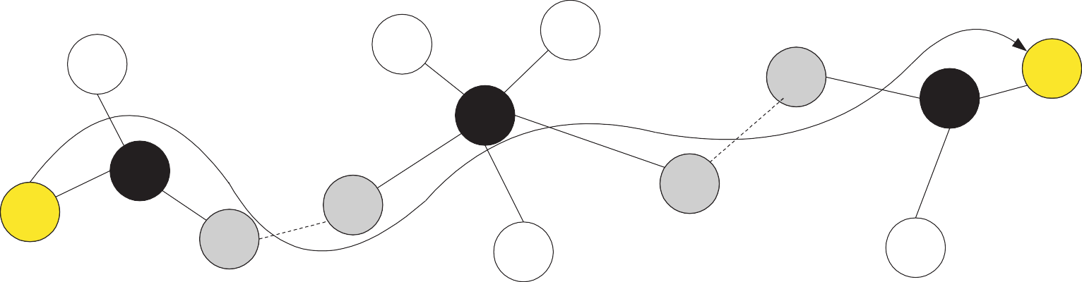
Ad hoc networks D.Moltchanov, TUT, 2009
Cluster head gateway switch routing protocol (GGSR)
It is characterized by the following:
nodes are organized into clusters, each having an elected cluster-head;
cluster head provides a coordination within its transmission range (single hop);
token-based scheduling is used within a cluster for sharing bandwidth between nodes;
all communications pass through the cluster head;
communication between cluster is done using the common nodes (gateways with two interfaces).
D
S
Abstract representation of routing in GGSR.

Slide 18
Ad hoc networks
D.Moltchanov, TUT, 2009
Two tables are used in CGSR:
Cluster member table containing the destination cluster head for every node;
Routing table containing the next-hop node for every destination cluster.
The protocol operates as follows:
a node obtains a token from its cluster head;
if this node has a packet to transmit, it determines the destination cluster head and next-hop;
routed packet goes as follows:
– a − H₁ − G₁ − H₂ − G₂ − · · · − H_{i} − G_{i} − · · · − G_{n} − H_{n} − b: where
G_{i} is the gateway i;
H_{i} is the cluster head i.
Route reconfiguration happens when:
there is a change in cluster heads;
stale entries are in cluster member table or routing table.

Slide 19
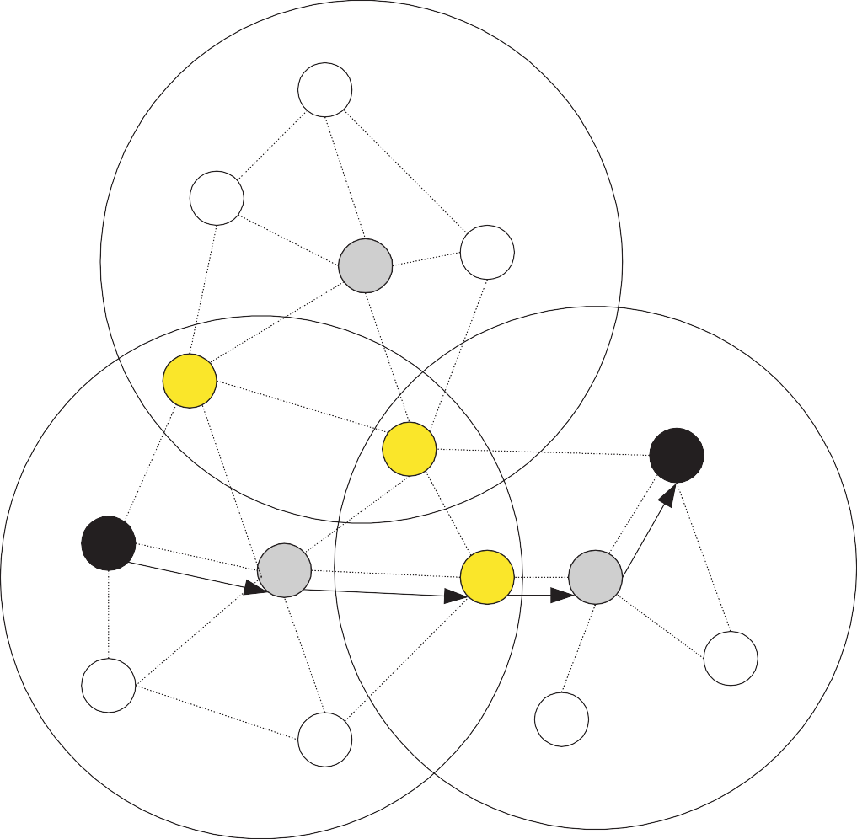
Gateway node
10
Cluster head
2
1
11
Source and destination
3
Destination
6
Source
5
9
12
14
7
8
15
Route path in CGSR.

Slide 20
Source-tree adaptive routing protocol (STAR)
There are two protocols with different aims:
Least overhead routing approach (LORA):
minimize control overhead irrespective of optimality;
Optimum routing approach (ORA):
provide optimal routes irrespective of the control overhead;
The STAR protocol operates as follows:
each node is required to:
send an update message to its neighbors during initialization;
send update messages about new destinations, chances of routing loops, costs of paths.
every node broadcasts its source-tree information:
wireless links used by the node in its preferred path to destinations.
every node builds its partial graph of topology based on:
its adjacent links with neighbors, source-tree broadcasts by neighbors.

Slide 21
7
6
7
6
8
3
8
3
5
5
1 4
1
4
2
2
Local topology construction.
The following method is used to find paths:
if a node 1 wishes to send data to node N and does not have path in its source tree:
it sends update message to all neighbors and indicates that there is no path to N ;
neighbor that have the path, responses with update messages;
node 1 updates its source tree and may begin transmission.

Slide 22
Reactive routing protocols
These protocols find paths to destination only when needed (on-demand) to transmit a packet.
We consider:
Dynamic source routing protocol (DSR);
Ad hoc on-demand distance vector routing protocol (AODV);
Location aided routing (LAR);
Associativity-based routing (ABR);
Signal stability-based adaptive routing protocol (SSA);
These protocols have the following advantages and shortcomings:
−: high delay of route setup process: routes are established on-demand;
• +: small control overhead: no route updates;
−: low scalability: no route updates;
−: low storage requirements: only needed routes are in cache.

Slide 23
Dynamic source routing protocol
This is a source-based routing protocol.
The difference between DSR and other on-demand routing protocols is:
on-demand protocols periodically exchange the so-called beacon (hello) packets:
– hello packets are used to inform neighbors about existence of the node.
DSR does not use hello packets.
The basic approach of this protocol is as follows:
during route contraction DSR floods a RouteRequest packets in the network;
intermediate nodes forward RouteRequest if it is not redundant;
destination node replies with RouteReply;
the RouteReply packet contains the path traversed by RouteRequest packet;
the receiver responds only if this is a first RouteRequest (not duplicate).

Slide 24
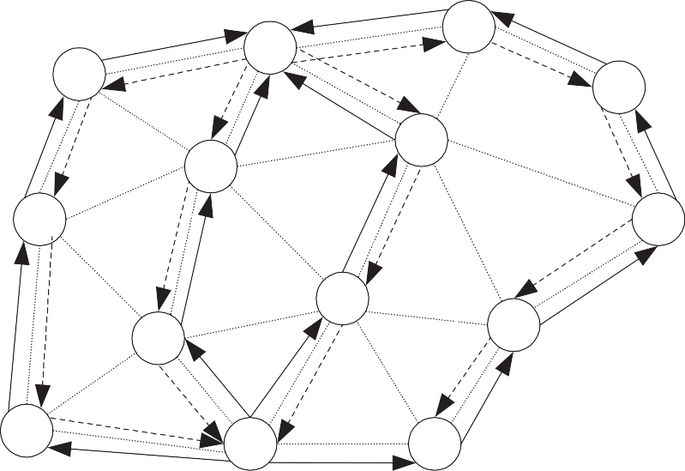
The DSR protocol uses the sequence numbers:
RouteRequest packet carries the path traversed and the sequence number;
the sequence numbers are used to prevent loop formation and nodes check it.
The DSR also uses route cache in each node:
if node has a route in the cache, this route is used.
R
8
12
7
10
9
13
6
4
5
2
14
S
16
Route establishment in DSR.

Slide 25
Ad hoc on-demand distance vector routing protocol
The major differences between AODV and DSR are as follows:
in DSR a data packet carries the complete path to be traversed;
in AODV nodes store the next hop information (hop-by-hop routing) for each data flow.
The RouteRequest packet in AODV carries the following information:
the source identifier (SrcID): this identifies the source;
the destination identifier (DestID): this identifies the destination to which the route is required;
the source sequence number (SrcSeqNum);
the destination sequence number (DestSeqNum): indicates the freshness of the route.
the broadcast identifier (BcastID): is used to discard multiple copies of the same RouteRequest.
the time to live (TTL): this is used to not allow loops.

Slide 26
The AODV protocol performs as follows:
when a node does not have a valid route to destination a RouteRequest is forwarded;
when intermediate node receives a RouteRequest packet two cases are possible:
if it does not have a valid route to destination, the node forwards it;
if it has a valid route, the node prepares a RouteReply message:
if the RouteRequest is received multiple times, the duplicate copies are discarded:
are determined comparing BcastID-SrcID pairs.
when RouteRequest is forwarded, the address of previous node and its BcastID are stored;
are needed to forward packets to the source.
if RouteReply is not received before a time expires, this entry is deleted;
either destination node or intermediate node responses with valid route;
when RouteRequest is forwarded back, the address of previous node and its BcastID are stored;
are needed to forward packets to the destination.

Slide 27
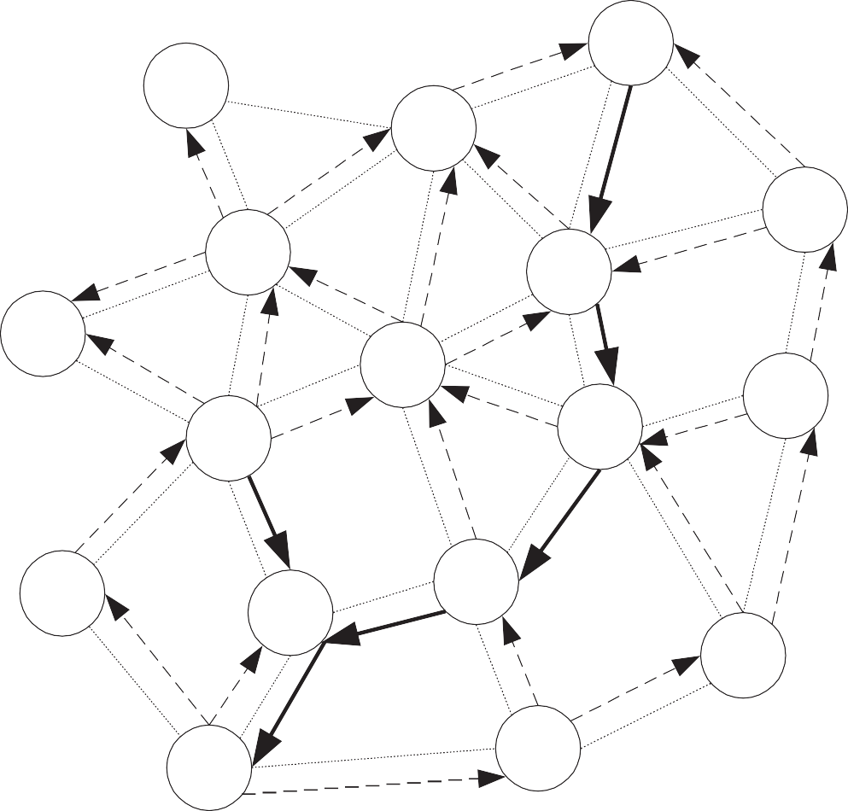
R
RouteRequest:
DestSeqNum:5,
SrcSeqNum: 2
Node 8:
DestSeqNum 3;
Node 9:
DestSeqNum 7;
17
14
13
11
12
16
8
6
9
7
10
1
2
5
S
4
Route establishment in AODV.

Slide 28
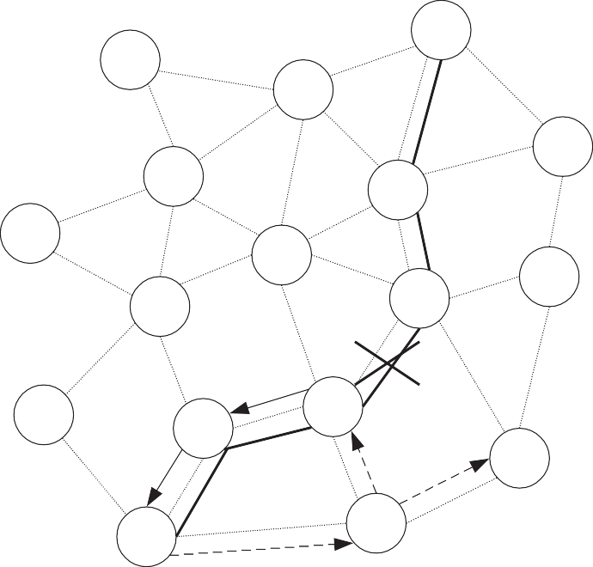
In case of the link break:
end-node are notified by unsolicited RouteReply with hop count set to ∞;
end-node deletes entries and establishes a new path using new BcastID;
link status is observed using the link-level beacons or link-level ACKs.
D
17
14
13
11
12
16
8
7
6
9
10
2
1
5
S
4
Route maintenance in AODV.

Slide 29
Location aided routing
What are basics of LAR:
uses the location information (assumes the availability of GPS);
reactive (on-demand) protocol.
LAR designates two zones for selective forwarding of control packets:
ExpectedZone:
This is a geographical zone in which the location of the terminal is predicted based on:
location of the terminal in the past;
mobility information of the terminal.
There is no info about previous location of the terminal the whole network is the ExpectedZone.
RequestZone:
This is a geographical zone within which control packets are allowed to propagate:
this area is determined by the sender of the data packet;
control packets are forwarded by node within a RequestZone only;
if the node is not found using the first RequestZone, the size of RequestZone is increased.

Slide 30
1
2
5
8
Dest.
3
10
9
6
3
Source
7
4
Example of ExpectedZone and RequestZone.
Nodes decide whether to forward or discard packets based on two algorithms:
LAR type 1;
LAR type 2.

Slide 31
LAR type 1 algorithm works as follows:
the sender explicitly specifies the RequestZone in the RouteRequest packet;
the RequestZone is the smallest rectangle that includes the source and the ExpectedZone;
when the node is in ExpectedZone, the RequestZone is reduced to the ExpectedZone;
if the ReouteRequest packet is received by the node within RequestZone, it forwards it.
1
2
5
8
Dest.
3
10
9
6
3
Source
7
4
Routing procedure in LAR type 1.

Slide 32
LAR type 2 algorithm operates as follows:
the sender includes the distance to the source in the RouteRequest packet;
intermediate nodes compute the distance to the destination:
if this distance is less than the distance between source and destination packet is forwarded;
otherwise the packet is discarded.
distance in the packet is updated at every node with lower distance to destination.
1
14
2
5
16
12
8
Dest.
17
3
9
10
13
6
Source
18
11
4
7
15
Routing procedure in LAR type 2.

Slide 33
Associativity-based routing
It is characterized by the following:
on-demand beacon-based protocol;
routes are selected based on temporal stability of wireless links:
to determine temporal stability, each node maintains the count of its neighbors’ beacons.
The protocol operates as follows:
source node floods the RouteRequest packet, all intermediate nodes forward this packet;
RouteRequest packet carries the following:
the path it has traversed;
the beacon count for corresponding node in the path.
when the first RouteRequest reaches the destination, the destination:
waits for RouteSelect time to receive multiple copies of RouteRequest;
selects the path that has the maximum number of stable links;
replies to the source with RouteReply packet.

Slide 34
1
14
Dest. 12
2
5
16
8
3
10
13
9
6
11
4
7
15
Source
4 - 7 - 10 - 5 - 14;
4 - 7 - 6 - 12 - 14;
4 - 9 - 8 - 1 - 5 - 14...
Routing in ABR.

Slide 35
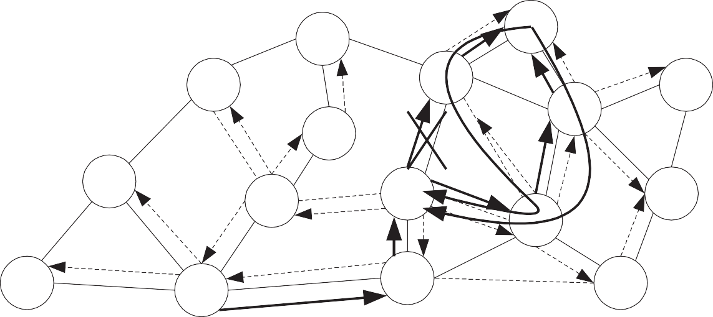
If the link break occurs:
the node closer to the source initiates a local link repair as follows:
– broadcasts locally route repair packet (local query (LQ)) with limited TTL (e.g., 3);
if this node fails to repair, then the next node closer to destination initiates a route repair;
if nodes constituting a half of pass of the route fail to repair, the source is informed.
1
14
Dest. 12
2
5
16
8
3
9
10
13
6
11
4
7
15
Source
Local route repair in ABR.

Slide 36
Signal stability-based adaptive routing protocol
This protocol is characterized by the following:
on-demand beacon-based protocol;
routes are selected based on temporal stability of wireless links:
based on temporal stability, each links is classified to:
stable
unstable
to determine temporal stability, each node measures the signal strength of beacons.
The whole protocols consist of the following two parts:
dynamic routing protocol (DRP):
DRP maintains the routing table interacting with DRPs on other hosts.
forwarding protocol (FP):
is responsible for forwarding of packets to destination.

Slide 37
In each node the signal stability table is maintained containing:
beacon count and signal strength of these beacons;
if the signal strength is strong for past few beacons the link is stable;
if the signal strength is weak for past few beacons the link is unstable.
The protocol operates as follows:
if no route in cache, the node floods the RouteRequest packet;
RouteRequest packet carries the path it has traversed;
if the intermediate node receives the RouteRequest via stable link it forwards it;
if the intermediate node receives the RouteRequest via unstable link it drops it;
when the first RouteRequest reaches the destination, the destination:
waits for RouteSelect time to receive multiple copies of RouteRequest;
selects the path that is most stable;
∗ if two or more paths are equal in stability, the shortest path is selected;
∗ if two or more shortest paths are available, random path among them is selected.
replies to the source with RouteReply packet.

Slide 38
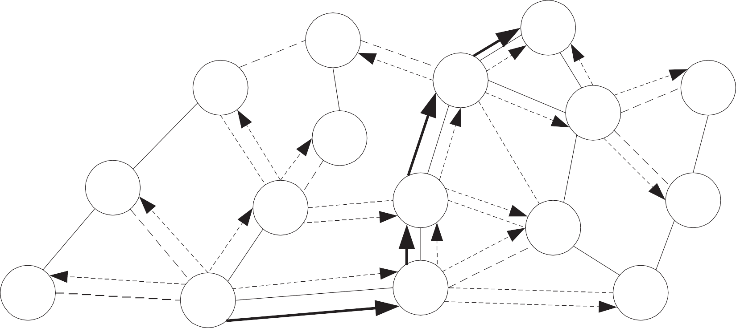
1
14
Dest. 12
2
5
16
8
3
10
13
9
6
11
4
7
15
Source
4 - 7 - 10 - 5 - 14;
4 - 7 - 10 - 5 - 12 - 14.
Routing in SSA.

Slide 39

In case of the link break:
end-nodes are informed and they try to establish new stable route;
of no stable routes are available, the restriction of stable links is removed.
1
14
Dest. 12
2
5
16
8
3
10
13
9
6
11
4
7
15
Source
4 - 7 - 10 - 5 - 14;
4 - 7 - 10 - 5 - 12 - 14.
Route repair in SSA.

Slide 40
Flow-oriented routing protocol
Aim is on supporting real-time traffic using a predictive multi-hop-handoff feature:
Classic protocols (e.g., DSR, AODV etc.):
route repair is initiated when intermediate node detects the link breaks;
it causes delay, losses: low QoS is provided in result.
FORP uses the predictive mechanism to estimate link expiration time (LET):
it is based on location, mobility and transmission range of nodes involved in forwarding;
the minimum of LET determines the route expiration time (RET);
it is assumed that GPS is used to make prediction of LET.
New shortcomings:
−: devises are expensive;
−: can only operate at the open air (due to GPS).

Slide 41
The protocol operates as follows:
if no route in cache, the destination floods the Flow-REQ packet carrying:
information regarding the source and destination nodes;
flow identification number (sequence number) that is unique for every session.
when neighbor receives the Flow-REQ packet:
to avoid looping checks if the sequence number if higher than that previously used;
if so, this node appends LET and its address in the packet, and forwards it;
if not, the packet is discarded.
when the destination receives the packet:
the packet has a path it has traversed and LET associated with each wireless link;
if RET is acceptable, it originates the Flow-SETUP packet.
when the source receives Flow-SETUP packet, it begins the transmission of packets.

Slide 42


1
Dest.
14
2
14 9
5
16
12
8
8
5
3
10
13
9
10
6
7
11
17
7
15
4
Source
4 - 7 - 10 - 5: RET: 8
4 - 9 - 8 - 1 - 5: RET: 5
Route establishment in FORP.

Slide 43
The LET of the link is estimated as follows:
2 2 2
−(pq + rs) + (p + r )T − (ps − qr)2
LET_{AB} =
X
,
p² + q²
q = X_{A} − X_{B}
s = Y_{A} − Y_{B},
p = V_{A} cos T_{A} − V_{B} cos T_{B}, r = V_{A} sin T_{A} − V_{B} sin T_{B},
(1)
A and B are nodes with transmission range T_{X} ;
V_{A} and V_{B} are velocities of nodes;
T_{A} and T_{B} are angles as shown below:
T_{A}
T_{B}
A: (X_{A},Y_{A})
B: (X_{B},Y_{B})
Motion angles in FORM.

Slide 44

FORP uses proactive route maintenance using available RET:
when the destination determines that the break is about to occur it sends Flow-HANDOFF;
Flow-HANDOFF propagates in the network similarly to Flow-REQ;
when many Flow-HANDOFF are received at the source new path with highest RET is chosen.
Dest.
14
5 - 10 - 7 - 4: RET: 5
1
5 - 1 - 8 - 9 - 4: RET: 8
5 - 1
5 - 6
2
14 9
8
5
16
- 3 - 4:
- 7 - 4:
RET: 3
RET: 7
6
12
8
5
5
7
3
3
10
13
9
10
9
6
7
11
17
7
15
4
Source
Route repair in FORP.

Slide 45
Hybrid routing protocols
These protocols maintain topology information up to m hops in tables.
We consider:
Zone routing protocol (ZRP);
Zone-based hierarchial link state routing protocol (ZHLS);
What are inherent shortcomings and advantages:
• +: fast link establishment;
• +: less overhead as compared to table-driven and reactive protocols.
−: high storage and processing requirements as compared to reactive protocols.
Note: a compromise between proactive and reactive protocols.

Slide 46
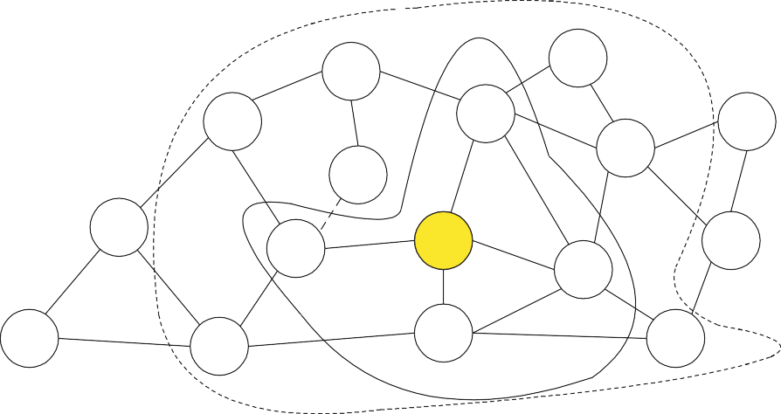
Zone routing protocol (ZRP)
This protocols uses a combination of proactive and reactive routing protocols:
proactive: in the neighborhood of r hops: Intra-zone routing protocol (IARP);
reactive: outside this zone: Inter-zone routing protocol (IERP).
r = 2
1
Dest.
14
5
r = 1
2
12
16
8
3
9
10
13
6
11
4
7
15
Source
For r = 2:
5, 6, 7, 9 are interior nodes
14, 12, 15, 4, 2, 8, 1 are paripheral nodes
Routing within a zone toplogy information is exchanged using route update packets.
Zones in ZRP for node 10.

Slide 47
The protocol operates as follows:
if the destination is within the zone, the source sends packets directly;
if not, the destination sends RouteRequest to peripheral nodes;
if any peripheral node, has the destination in its zone it replies with RouteReply;
if not, peripheral nodes sends RouteRequest to their peripheral nodes and so on;
if multiple RouteReply are received the best is chosen based on some metric.
If the broken link is detected:
intermediate node repairs the link locally bypassing it (proactive routing!!!);
end nodes are informed;
sub-optimal pass but very quick procedure;
after several local reconfiguration, the source initiates global pass finding to find optimal.

Slide 48
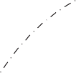


1
14
2
5
16
12
8
Source
3
10
13
9
6
11
4
7
15
Dest.
Routing in ZRP with r = 1.

Slide 49
Zone-based hierarchial link state routing protocol
ZHLS is characterized by the following:
use of geographical location of nodes to determine the non-overlapping zones;
hierarchial addressing with zone ID and node ID is used;
each node requires the location information based on which its zone is obtained;
topology information is maintained in every node inside this zone;
for regions outside the zone, zone connectivity information is maintained;
The ZHLS uses:
proactive routing is used inside zone;
reactive routing is used outside zone;
Note: ZHLS requires GPS or similar service to identify itself with a certain sone.
Zones: coverage of the single node, application scenario, mobility of nodes, network size.

Slide 50
The protocol operates as follows:
each node builds a one-hop node-level topology;
this one-hop topology is propagated to other nodes in its zone using packet containing:
– IDs of all zones in the zone, node ID, and zone IDs of all other nodes.
nodes that receive responses from nodes belonging to other zones are gateway nodes;
all traffic between zones is transmitted via gateway nodes;
once node-level topology is built, nodes obtain zone-level topology sending packets via gates;
if the destination is in the zone, packets are forwarded directly;
if no, the source sends location request packet to every zone via gateways;
every gateway node checks for destination in its routing table and replies with ReouteReply.

Slide 51
1
14
D
C
2
B
A
16
5
12
8
3
10
13
9
6
11
H
G
7
F
E
4
15
ZHLS zones.
The repair of broken links is as follows:
source is notified about the link failures;
if there are multiple gateways with the required zone, packet if forwarded via one of those;
if no multiple gateways, packets are forwarded to other zones and then to the required zone.

Slide 52
Hierarchial routing protocols
These protocols introduce hierarchy in the network to achieve the following benefits:
reduction in the size of routing tables;
better scalability.
Hierarchial state routing protocol
HSR is characterized by the following:
HSR uses multi-clustering to enhance resource allocation and management;
HSR defines different levels of clusters;
at every level leader is elected;
the first level is made of single-hop clusters (physical clustering);
the next level is comprised of leaders of clusters.

Slide 53
Level 2
Level 1
Level 0
5
16
2
12
20
8
18
3
9
10
13
6
17
11
4
7
15
19
Topology example in HSR.

Slide 54
At the physical layer nodes are classified into:
cluster heads; belong to a single cluster and elected as a cluster head;
gateway nodes; belong to two or more clusters;
normal nodes: belong to a single cluster.
Cluster heads at level 0 (physical level) could be responsible for:
slot/frequency/code allocation to utilize spectrum more efficiently;
call admission control from normal member nodes;
scheduling of packets for transmission;
exchange of routing information;
handling route breaks.
Gateway nodes are responsible for:
forwarding of packets between different clusters (cluster heads).

Slide 55
The following routing responsibilities are assigned to nodes in HSR:
every node maintains information about the status of links with its neighbors:
this information is broadcasted within the cluster at regular intervals.
cluster heads exchange the topology and link state information at any level:
this is done via multiple hops using the gateway nodes.
the path between two cluster head involves multiple links is called the virtual link:
this is: head - gateway - head - gateway etc.
every node knows the exact hierarchial topology information:
after obtaining the information the cluster head floods it to lower level.
to route packets hierarchial addressing is used consisting of;
hierarchial ID (HID): sequence of cluster headers’ IDs from higher level;
node ID: similar to unique MAC address. Address of node 12: (9,12,12).
From 12 to 3: 12 - 9 - 3 over multiple links.

Slide 56
Fisheye state routing protocol
Generalization of the GSR protocol where the following property is introduced:
accurate information about nodes in local topology;
not so accurate information about node that are far away.
Why is it needed:
complexity proactive routing: size of the network, mobility of node;
reactive routing: + number of connections.
What is the basis:
a node exchanges the routing information only with neighbors at periodic intervals:
trade-off between link-state (topology exchanges) and distance vector (link-level info).
the complete topology information is maintained at each nodes;
different update frequencies for different scopes one-hop/two-hop/... scopes:
one-hop – highest freq., two-hop less freq. etc.: decrease of the message size.

Slide 57
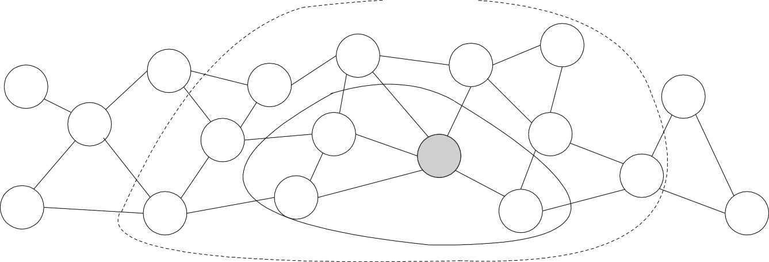
5
16
2
12
20
8
18
3
9
10
13
6
17
11
4
7
15
19
Figure 29: One-hop and two-hop scopes of the node.
2
Dest. | Neigh. | Hops
1 | 2,3 | 0
2 | 1 | 1
3 | 1,4 | 1
4 | 3 | 2
1
one-hop neighbors
4
3
two-hop neighbors
Example of topology information in FSR.

Slide 58
Ad hoc networks D.Moltchanov, TUT, 2009
Power-aware routing protocols
The following metrics can be taken into account on route selection procedure:
Minimal energy consumption per a packet:
This metric involves a number of nodes from source to destination.
– +: uniform consumption of power throughout the network;
Maximize the network connectivity:
To balance the load between the cut-sets (those nodes removal of which causes partitions).
– −: difficult to achieve due to variable traffic origination.
Minimum variance in node power levels:
To distribute load such that power consumption pattern remains uniform across nodes.
– +: nearly optimal performance is achieved by routing a packet to least loaded next-hop.
Minimum cost per a packet:
Cost as a function of the battery charge (less energy – more cost) and use it as a metric.
– +: easy to compute (battery discharge patterns are available);
– +: this metric handles congestions in the network.

Slide 59

Next Generation Network (NGN)

Slide 60
CONTENTS
INTRODUCTION
EXISTING NETWORKS & THEIR DISADVANTAGES
NGN : DEFINATION
CHARACTERSTICS OF NGN
NGN ARCHITECTURE
NGN IN INDIA
CONCLUSION

Slide 61
INTRODUCTION
Today ,telephony,the internet,and the cellular mobile networks continue to be different domains,each has its own protocols and services.
Telecommunication industry is changing at a rapid pace. This change in the industry is basically driven by demand of new services from subscriber's side and urge to reduce CAPEX (Capital Expenditure) and OPEX (Operational Expenditure) from carrier side.

Slide 62
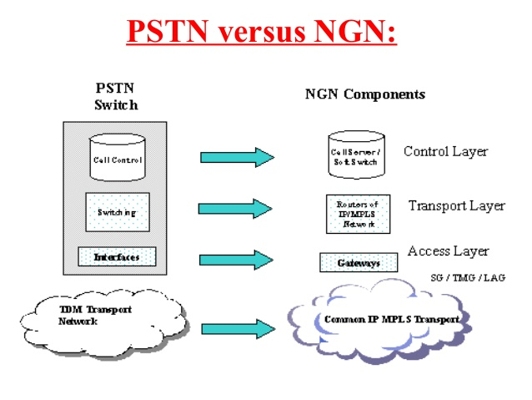
NGN will be the foundation for creation of a new range of multimedia applications that takes full advantage of characterstics of broadband network .

Slide 63
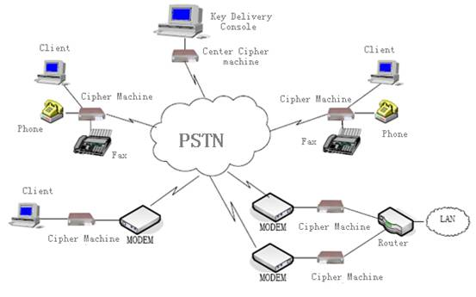
EXISTING NETWORK
Presently telecommunications system employs one of the three types of the following networks:
PSTN: Public Switch Telephone Network was basically developed and engineered for giving voice connectivity to the wire line subscribers.

Slide 64
2) PLMN (Public Land Mobile Network): PLMN has been developed to provide voice services for wireless subscribers
3) Data Network: This network was basically designed for accessing remote files and servers for defense people and universities but now a days nobody can think of living without data network services. The basic and most popular application of data networks is Internet. Other applications include E-commerce, online banking, online gaming, E-shopping

Slide 65
DISADVANTAGES
Slow to develop new technologies
Not compatible for IP platform
No convergence features
High CAPEX & OPEX due to maintenance of different networks for different services.
Large Power, Cooling requirements.

Slide 66
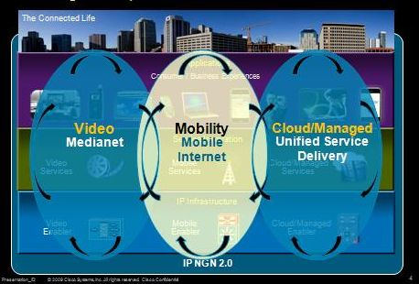
NGN : DEFINATION
A Next Generation Network (NGN) is a packet-based network able to provide Telecommunication Services to users and able to make use of multiple broadband, QoS enabled transport technologies and in which service-related functions are independent of the underlying transport-related technologies.

Slide 67
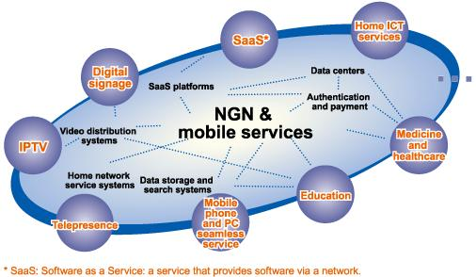
NGN’s are commonly built around the internet protocol, & therefore the term “ALL IP” is also used to describe them.

Slide 68
CHARACTERSTICS OF NGN
1) Packet based Transfer
As per the new 4G and 5G technologies the NGN is also a packet technology. The packet-based networks provide for a higher speed and a bandwidth efficient system.
With the increase in number of users and the need for high speed technology at the same time, packet based systems are a boon to the service providers

Slide 69
2) Decoupling of service provision from transport-
In an NGN,this means that whenever a provider wants to enable a new service, they can do so by defining it directly at the service layer without considering the transport layer i.e. services are independent of transport details.
3) Support for a Wide range of Services
New and advanced devices which combine all the existing services and devices into one which serves for Customer satisfaction and also makes it easy for the service providers at the same time.

Slide 70
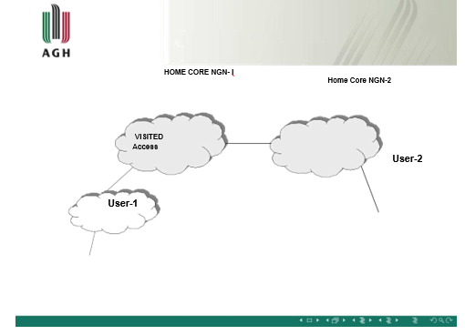
4) GENERALISED MOBILITY:

Slide 71
ARCHITECTURE OF NGN
A basic architecture was defined comprising network elements needed for the provision of traditional telephony services.
The Next Generation Network architecture is based on four layers: ACCESS LAYER , CORE LAYER, CONTROL LAYER and SERVICE LAYER .

Slide 72
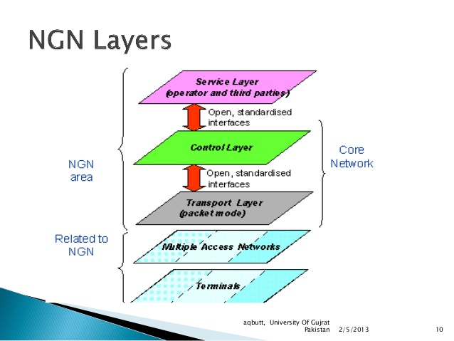

Slide 73
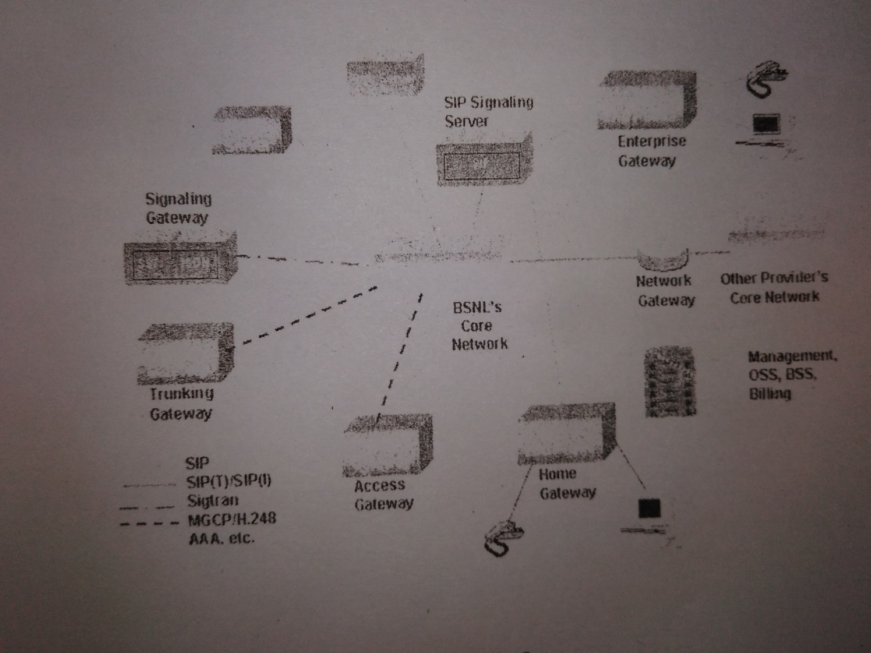
ARCHITECTURE DIAGRAM

Slide 74
NGN IN INDIA
National Centre for Next Generation Network (NCNGN) Circle has been created by the Management Committee of BSNL Board in its 168th meeting held on 26th day of June 2013. The NCNGN Circle with its headquarter at New Delhi would be responsible for NGN project coordination during installation and commissioning.

Slide 75
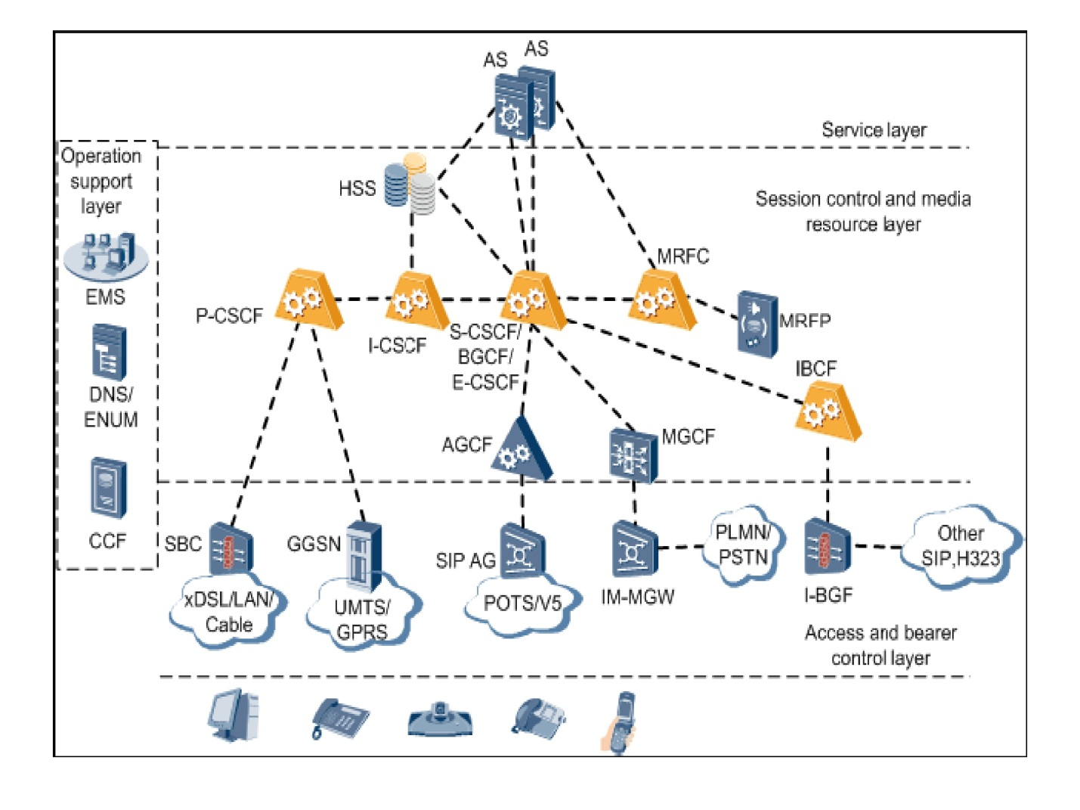
NGN
IN INDIA BY BSNL

Slide 76
CONCLUSION
The creation of the NGN is no overnight transformation, but it is an evolution that is already underway and gathering pace.
With the fast paced modern lifestyle and growing need for data access, the Next Generation Networks are being designed which combine all forms of data access into one. The NGN system works like a black box which encapsulates all the services into one.
The NGN network is highly advantageous due to this facility, for both customers and service providers.

